Slide 1

Software development project Of Connect4 game with AI
Submitted By:
Sabiha Islam-1604070
Maruf Hasan-1604089
Supervised By:
Dr. Md. Iqbal Hasan Sarker
(Assistant Professor)
Animesh Chandra Roy
(Assistant Professor)
Md. Billal Hossain
(Lecturer)

Slide 2
Introduction
AI , intelligence demonstrated by machines in contrast
natural intelligence displayed by humans.
Ability of a digital computer or computer-controlled
robot to perform tasks of intelligent beings.
Build board game Connect4 which is a vast area of AI.

Slide 3
Objectives
Human v/s human game plot
Human v/s AI game plot
Level of AI

Slide 4
Related works
Using the combination of conspiracy-number search,
search tables and depth-first-search, A Shannon C-type
strategy program, VICTOR used with Connect4
Propose a new variant of TCL with geometric step size changes.
Zero-sum approach which was not being popular and
less effective
Difficulty in human win by using VICTOR.

Slide 5
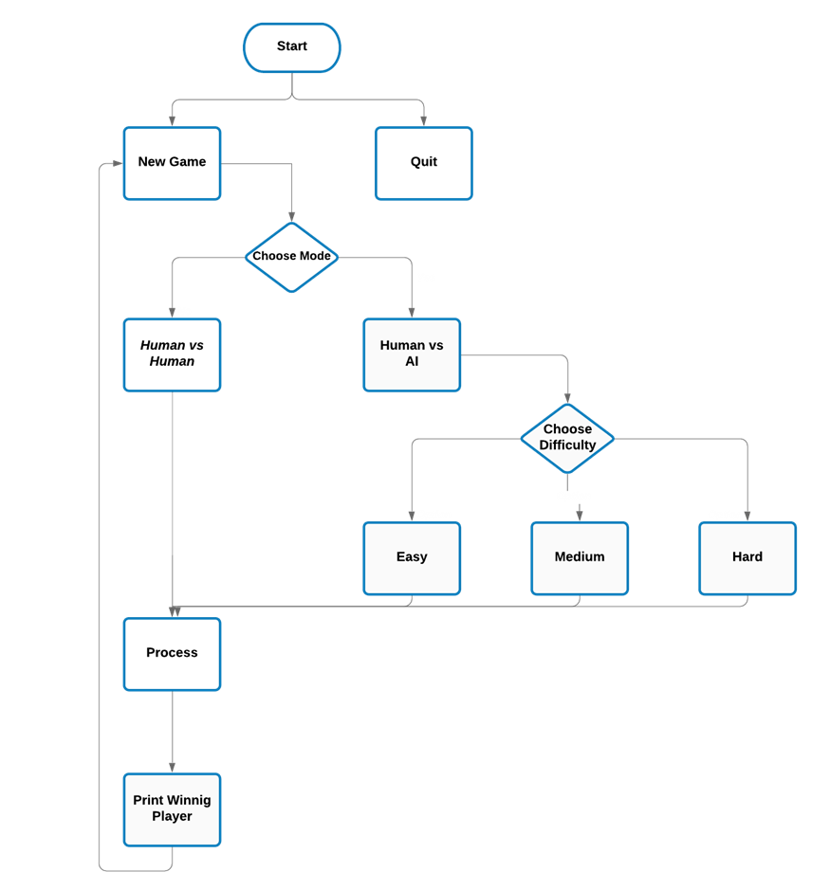
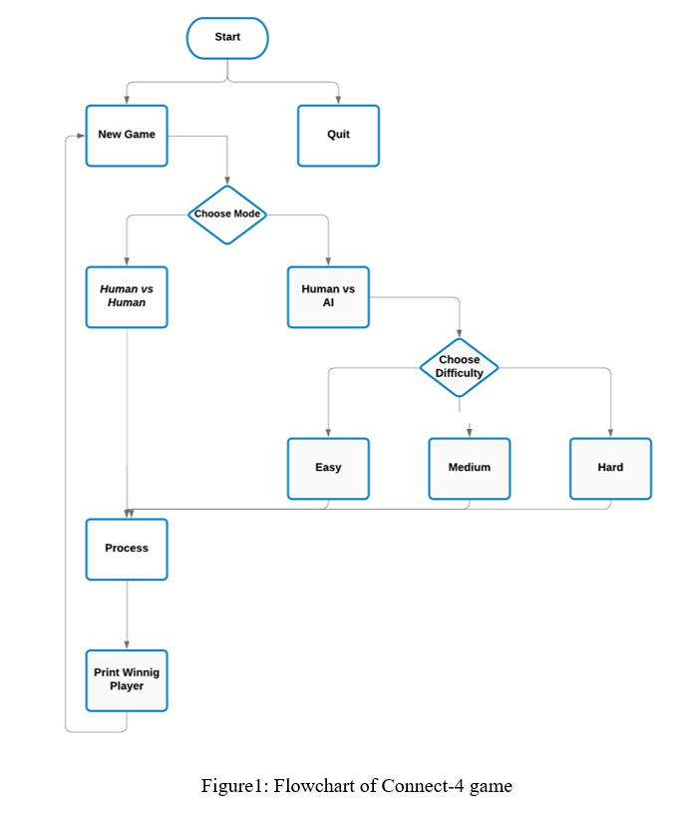
Methodology

Slide 6
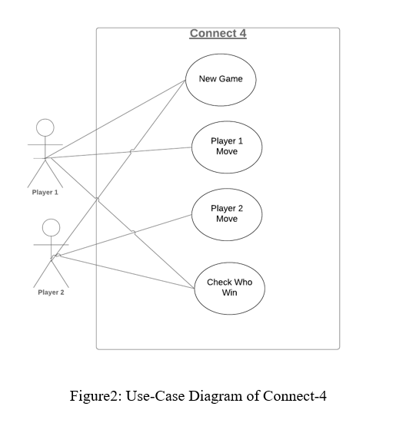
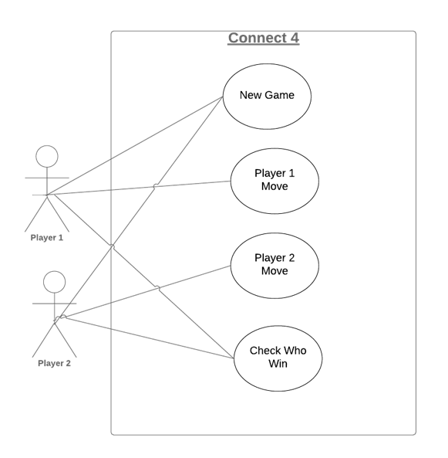
Methodology(Cont.)

Slide 7
Implementation
Platform for this game: Sublime Text Editor, Anaconda
Language: Python
Package needed: pygame, NumPy, math
PC Configuration: Any PC that could be installed Linux, Windows or other operating system. Also a dual core Pentium 4 or AMD A4/6 processor with minimum 2GB of RAM would be enough.

Slide 8
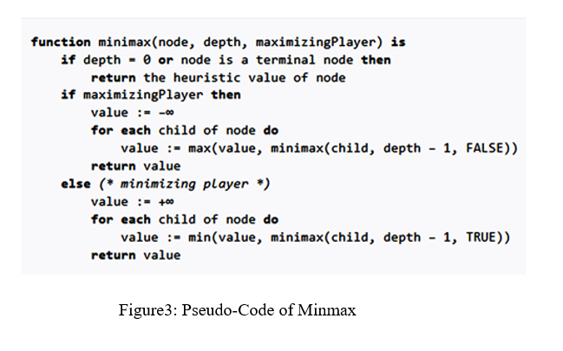
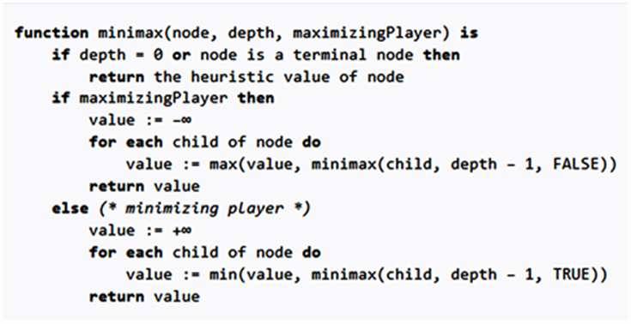
Implementation(Cont.)

Slide 9
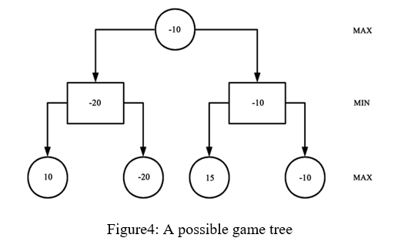
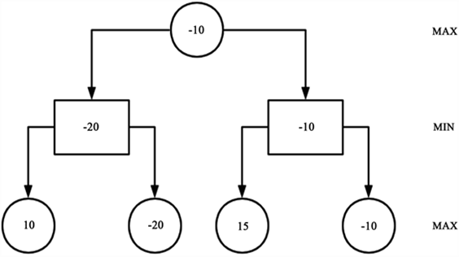
Implementation(Cont.)

Slide 10
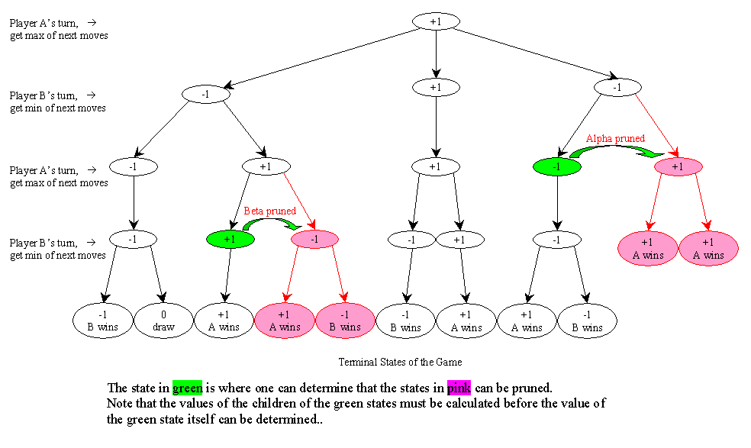
Implementation(Cont.)

Slide 11
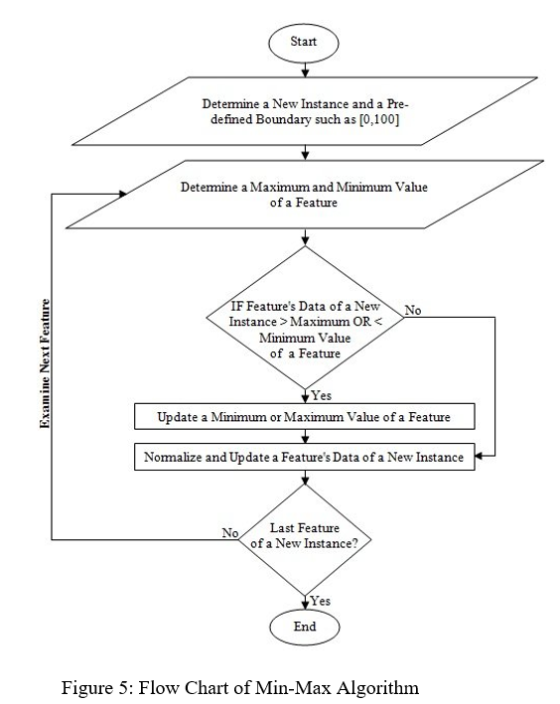
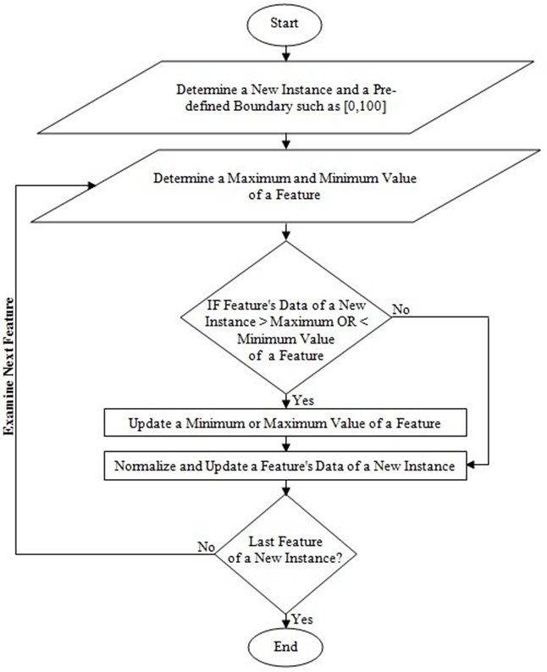
Implementation(Cont.)

Slide 12
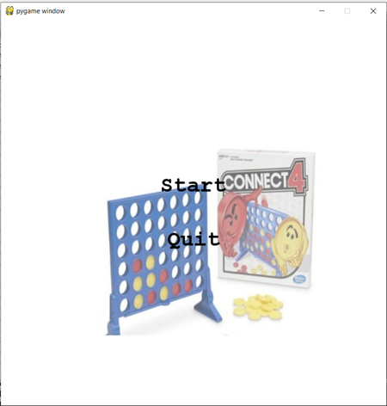
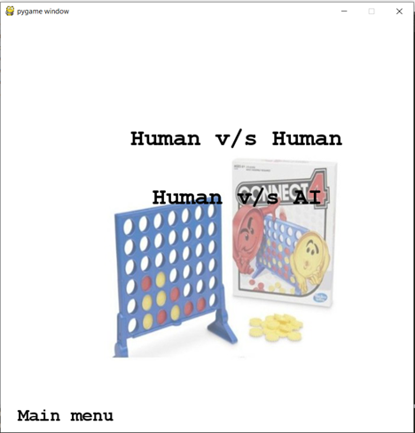
Result & Output
Figure 6 : Start menu
Figure 7 : Choose mode

Slide 13
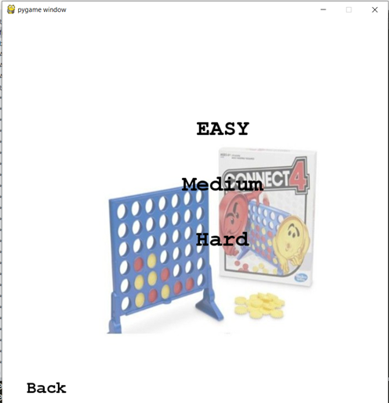
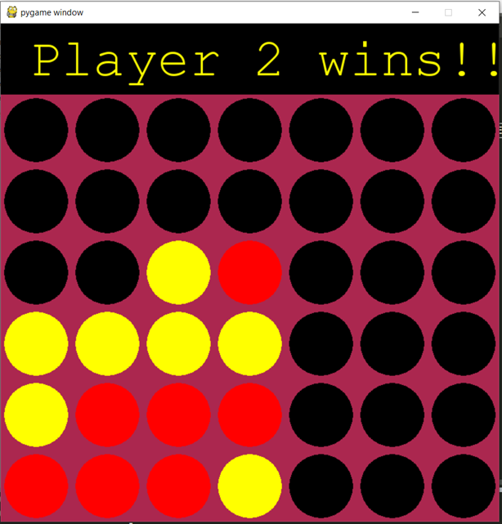
Result & Output(Cont.)
Figure 8 : Select Difficulty
Figure 9 : Playing games

Slide 14
Limitations
Not android application based game
Can only run in project environment
Player moves slow
Board size of the game fixed(6x7)

Slide 15
Conclusion
Gather knowledge about AI & board game.
Try to solve the limitations in future.
Know about different types of algorithms.
Know about Python programming language.

Slide 16


Slide 17


